Slide 1
Chapter 16

Slide 2
Objectives

Slide 3
A file with two classes coded one after the other

Slide 4
A file with nested classes

Slide 5
A Customer class that’s split into two files

Slide 6
A Form class that’s split into two files

Slide 7
Code that declares a namespace

Slide 8
Code that declares nested namespaces

Slide 9
Part of a Validator class with XML documentation

Slide 10
Part of a Validator class with XML documentation (cont.)

Slide 11
XML elements for class documentation

Slide 12
A screen tip with documentation for a method

Slide 13
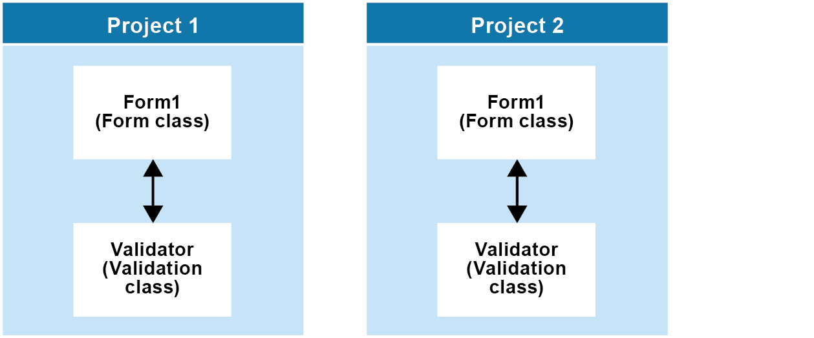
Two projects that use the Validator class

Slide 14
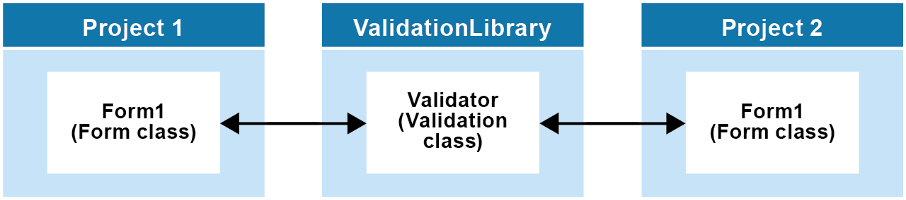
Two projects that access the Validator class via a class library

Slide 15
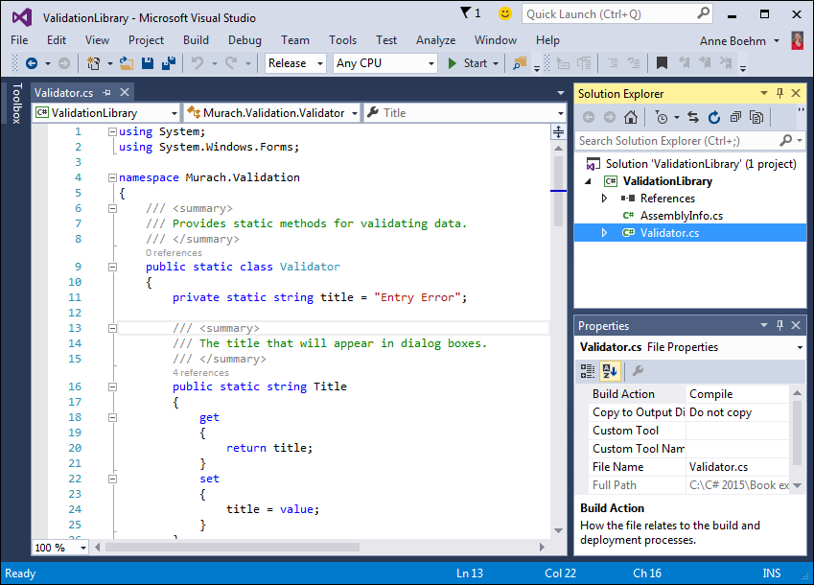
A class library project

Slide 16
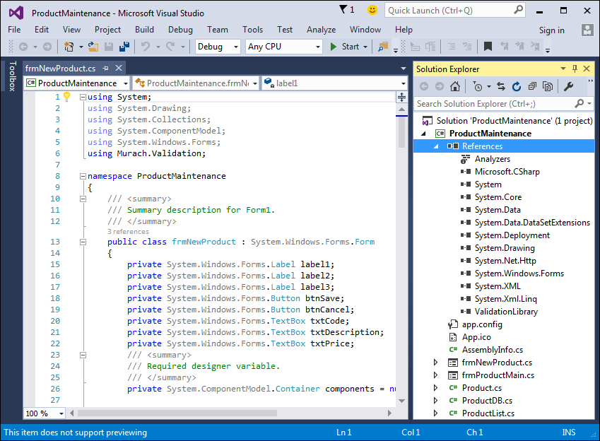
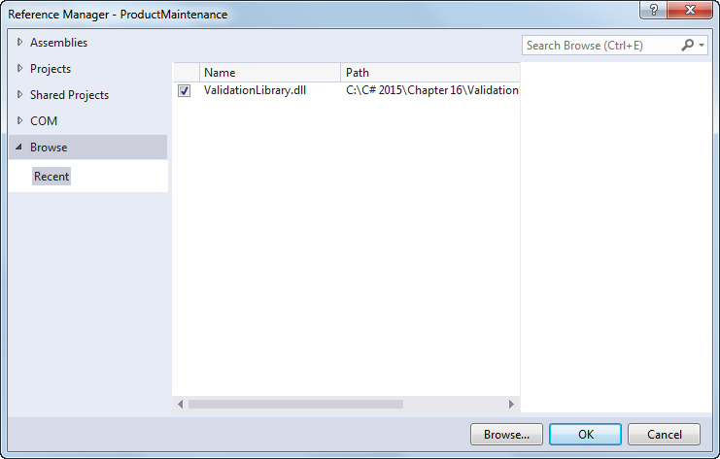
A project with a reference to a class library

Slide 17
A using directive for the validation class library

